Slide 1
Cobb County’s Gifted Eligibility Process

Slide 2
Referrals
Automatic
System-wide assessment – ITBS, CogAT, Renzullis
Reported
Reciprocity
Only in state

Slide 3
State Law
Two Options for Eligibility
Option A/Psychometric: A student must meet eligibility requirements in both Mental Abilities and Achievement.
Option B/ Multiple Criteria: A student must meet eligibility requirements in three of the four following areas: Mental Abilities, Achievement, Creativity, and Motivation.

Slide 4
Determination of Eligibility
Option A/Psychometric: A student must meet eligibility requirements in both areas:
Mental Ability: 96th percentile (3-12) or 99th percentile (K-2) on a standardized test of mental ability - Composite Score only.
Achievement: 90th percentile in total battery, total reading, or total math section of a standardized achievement battery .

Slide 5
Determination of Eligibility
Option B/ Multiple Criteria: A student must meet eligibility requirements in three of the four following areas:
Mental Ability: 96th percentile on a standardized test of mental ability - Component or Composite score
Achievement: 90th percentile in total battery, total reading, or total math section of a standardized achievement battery
Creativity: 90th percentile / 90th percent on a creativity assessment
Motivation: 90th percentile / 90th percent on a motivation assessment

Slide 6
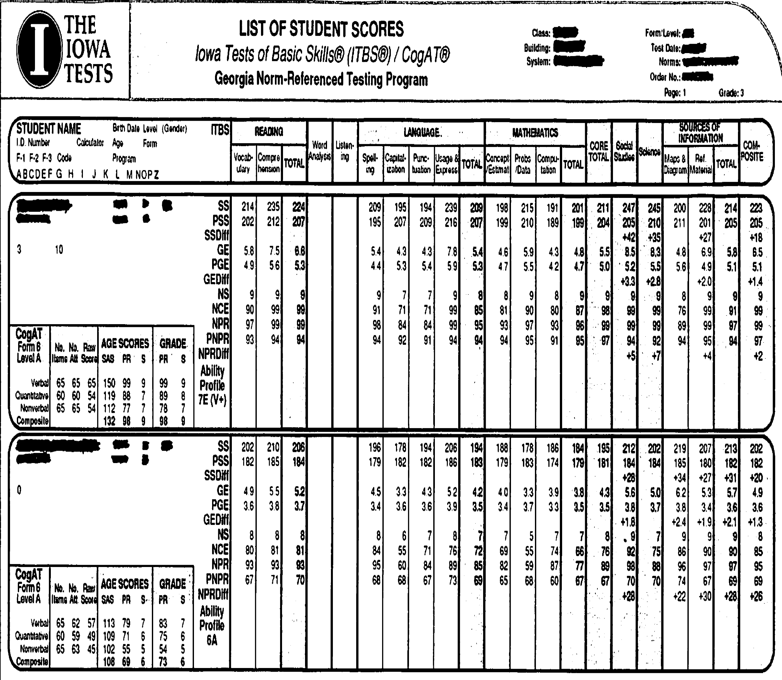
Sample Score Report
Notes:
We use the age percentile scores on the mental abilities assessment and grade percentile scores on the achievement – this is determined by the state

Slide 7
Assessments used
Mental abilities- Cognitive Abilities Test (CogAT), Otis-Lennon School Ability Test (OLSAT), Naglieri Nonverbal Abilities Test (NNAT)
Achievement- Iowa Test of Basic Skills (ITBS), Stanford Achievement Test (SAT-10)
Creativity- Renzulli Behavioral Rating Scale for Creativity (1-12), Torrance Test of Creative Thinking (TTCT)
Motivation- Renzulli Behavioral Rating Scale for Motivation (1-12), motivation portfolio (1-3); Children’s Academic Intrinsic Motivation Inventory(CAIMI) (4-5)

Slide 8
Renzulli Rating Scales
Based on behaviors observed in the classroom over a minimum of nine weeks
All teachers receive training on identifying behaviors that exemplify characteristics of creativity and motivation specific to gifted children.

Slide 9
Example of Creativity
Creativity Characteristic – The student demonstrates the ability to generate a large number of ideas or solutions to problems or questions.
Behaviors: good problem solver, thinks of different ways of doing things, trouble settling on one idea, and therefore, may have difficulty beginning tasks.

Slide 10
Example of Motivation
Motivation Characteristic – The student demonstrates tenacity for finding out information on topics of interest.
Behaviors: seeks opportunities to find more information about a topic beyond what is presented in class, is able to contribute additional information on topics discussed in class due to independent research, student may be too focused on one topic.

Slide 11
Kindergarten
Although we do not formally assess kindergarteners for gifted service, we do serve them through the collaboration model when requested by the regular education teacher.

Slide 12
Testing Window
Refer to the Cobb County testing calendar for system-wide testing dates and grade levels.
Gifted eligibility evaluation begins once system-wide test scores are received and reviewed by Target teacher.

Slide 13
Delivery Models for Gifted Service
Elementary
One day a week, resource class
Interdisciplinary curriculum
Middle School
Advanced content classes
Placement based on demonstrated need in content areas
Specific criteria for placement determined by local school
High School
Honors and Advanced Placement classes

Slide 14
Thank you for your interest in gifted eligibility and service.

